Slide 1
APP DESIGN
Liane Stevenson @webdevelopwolf www.webdevelopwolf.com

Slide 2
INTRODUCTION
What to learn

Slide 3
What are we doing today?
Why design our apps?
Stages of app design
Benefits of app design

Slide 4
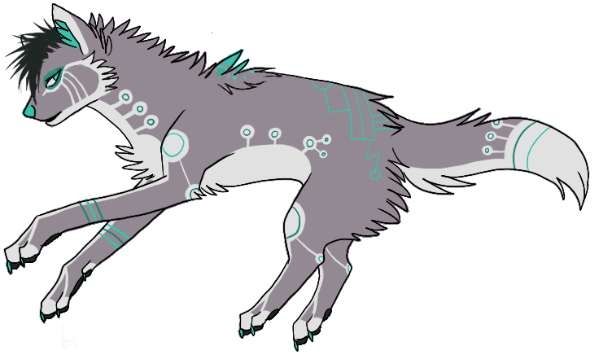
Need help?
Github:
http://www.github.com/webdevelopwolf/training
Twitter:
http://www.twitter.com/webdevelopwolf
Facebook:
http://www.facebook.com/webdevwolf

Slide 5
APPLICATION DESIGN
Those who fail to plan…

Slide 6
WHY CAN’T WE JUST GET STRAIGHT IN THERE AND START CODING???
A mobile app is released on iOS or Android at least 8 times a day.
Most global corporations have development teams to match their size
Apple application quality
‘Get it right first time’

Slide 7
RULES OF APP DEVELOPMENT
Don’t worry there’s only eight of them…

Slide 8
8 RULES OF MOBILE APPLICATION DEVELOPMENT
1 Define the project
2 Know your enemy user
3 Involve the stakeholder
4 Storyboarding
5 Collect all data
6 Build an interface
7 Link to your data
8 Test and release

Slide 9
STEP 1 – DEFINE THE PROJECT
Is our app a need, or a want?

Slide 10
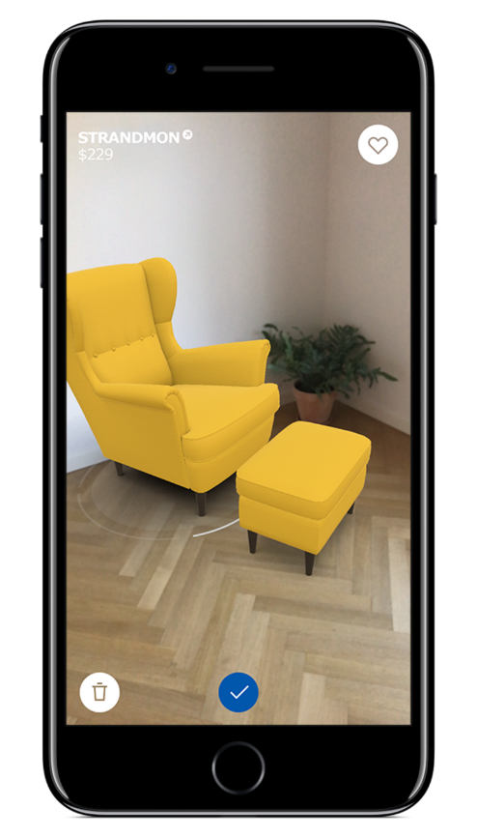
Step 1 Define the Project
Should exist to fix a real-world problem
Booking App - Hair Salon
Product Catalogue - Furniture Store
Food Delivery – Take Away
Therefore every app has a mission
Book on-the-move
Browse at leisure
Track their food

Slide 11
Step 1 Define the Project
“To design and build an application that allows our customers to track their deliveries so that they may avoid waiting home for parcels”

Slide 12
STEP 2 – KNOW YOUR USER
Our apps sit rep…

Slide 13
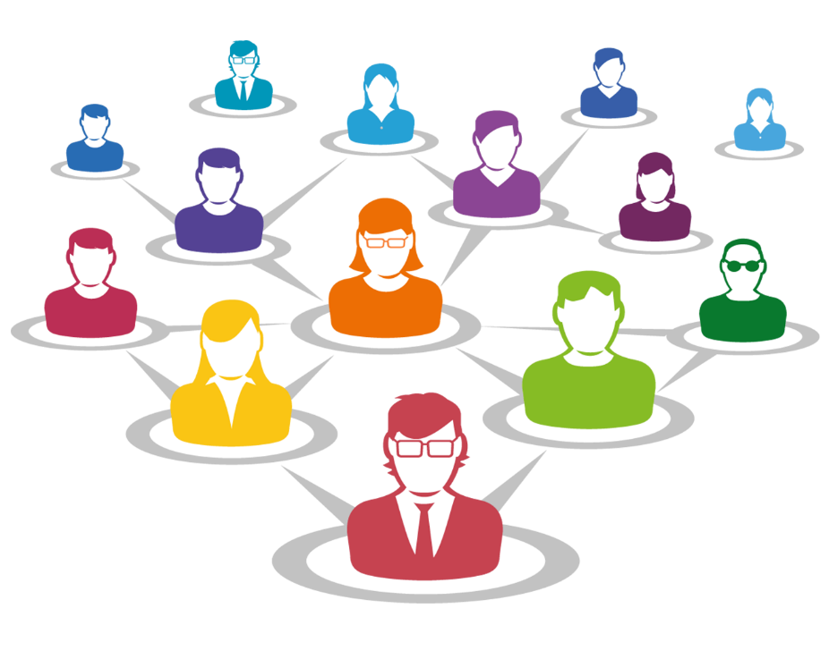
Step 2 Know Your User
The more you know about your user, the more you know about your app
Users groups for Facebook:
Keep in touch
Online photo album
Promotion
Viral messages
All of these groups will use Facebook differently

Slide 14
Step 2 Know Your User
The users for our tracking app fall into two groups:
Drivers
Customers
Both groups need:
Easy-to-use
Secure
Accessible
These give us the app’s requirements

Slide 15
STEP 3- STAKEHOLDERS
Getting people as excited about your app as you are!

Slide 16

Step 3 Involve Your Stakeholders
Who or what is a stakeholder?
Users
Employers
Clients
Customers
And any one else who is effected by the success of your app
Talk to people
Take on board criticism
Don’t let them run the project

Slide 17
STEP 4 - STORYBOARDING
Every application tells a story…

Slide 18

Step 4 Storyboarding
The story of how we get from A to B
Answers questions about how users will user your app
Does it flow?
Is it easy to get the job done?
Are there any blockers or hurdles?

Slide 19
Step 4 Storyboarding
Making a storyboard:
Pen & Paper
Post-it notes or index cards
Online tools such as InVision or Canva
Desktop tools like Photoshop or Gimp

Slide 20
STEP 5 –GATHERING DATA
Round up all those bits and bytes…

Slide 21
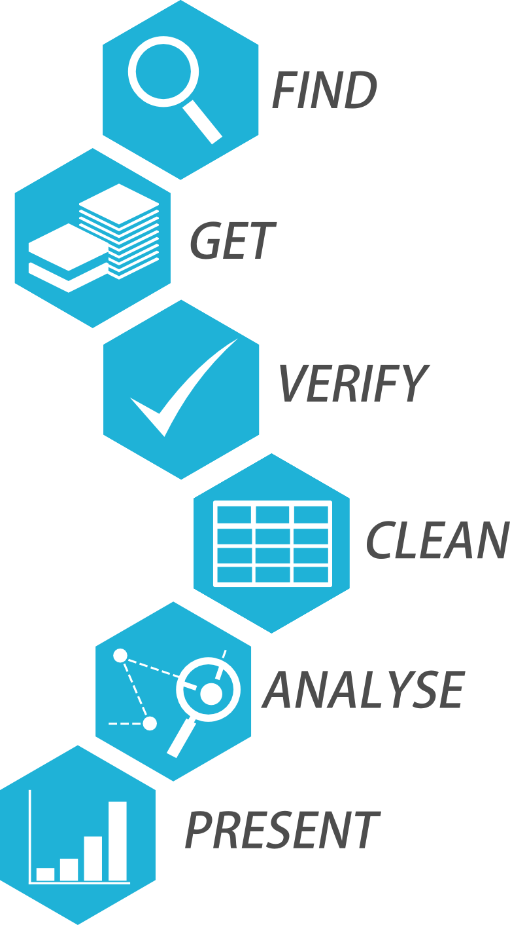
Step 5 Collate All Your Data
Our app is going to contain static and dynamic data
Static data doesn’t change
Dynamic data can and will change
At this stage of the project we only need to worry about collating static data

Slide 22
Step 5 Collate All Your Data
This is less important for a personal project but can be crucial when working on a commercial project
Best way to do this is to construct a spreadsheet

Slide 23
STEP 6 – BUILDING A USER INTERFACE
Let’s put our app’s best face on…

Slide 24
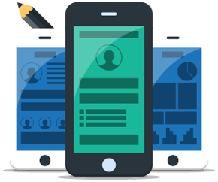
Step 6 Build A User Interface
Some things we need to be thinking about:
Is it accessible?
Is it pleasing to your target audience?
Does it suit a touch screen display?
Ionic will handle most of this
If you plan to use your own designs these points need consideration

Slide 25
STEP 7 – BRINGING IT ALL TOGETHER
Getting your app plugged in…

Slide 26
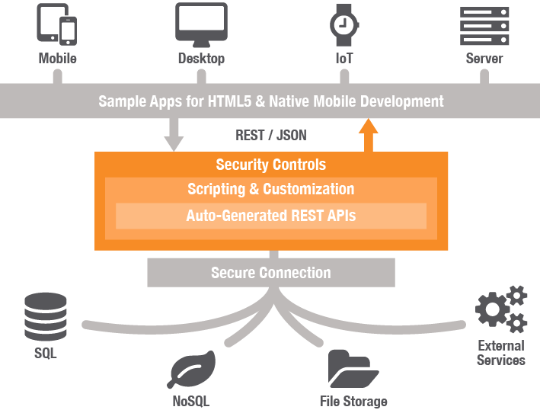
Step 7 Hooking Into Your Data
These are our dynamic data sources
How do we want to get our data?
Where do we want to store our data?
How easy would it be to intercept?
Will our app still load if this data were unavailable?
Our API will be a C# Web API 2.0 app serving JSON data

Slide 27
STEP 8 – TESTING AND RELEASE
The really exciting bits…

Slide 28
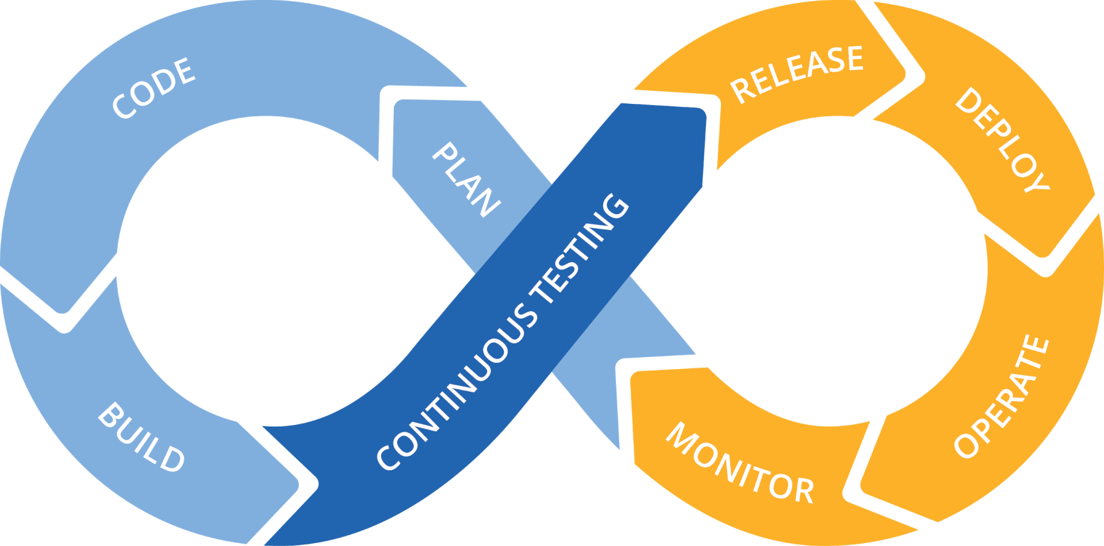
Step 8 Test & Release App Cycle
Why is testing important? Because users are too…
They break what’s there
They ask for what’s not there
They use what’s there for something completely different
They complain about things you never knew existed until they complained

Slide 29
Step 8 Test & Release App Cycle
When it comes to release time you have a few options:
Cloud release
Web hosting
Host from home

Slide 30
WHAT DID WE LEARN THIS TIME?
Why design our apps?
Stages of app design
Benefits of app design

Slide 31
THIS SECTION’S CHALLENGE!
Take my resources and design your own application, it can be something for fun, or something you’ve wanted to build for a while.
For bonus points, get feed back from at least one person on your idea – ways you can do this are:
Share it with the rest of the group on our Slack board and swap ideas and critique each others plans
Or ask a family member or a friend
Post it on Twitter, Reddit, Facebook etc.

Slide 32
Need help?
Github:
http://www.github.com/webdevelopwolf/training
Twitter:
http://www.twitter.com/webdevelopwolf
Facebook:
http://www.facebook.com/webdevwolf

Slide 33

Next Section…
We’re going to be learning all about Ionic and the role it’s going to play in our project…

